Slide 1

Advanced Python
Data Visualisation

Slide 2
Module 4A: Data Visualisation ~ Matplotlib ~

Slide 3
Module Objectives After completing this module you will be able to
Create line plot
Create scatterplot
Create column plot
Create bar plot
Create subplots
Add plot title
Add legend
Add axis name

Slide 4


4

Slide 5
Matplotlib: introduction
Visualisation is any technique for creating images, diagrams, or animations to communicate a message.
Data Visualisation refers to the techniques used to communicate data or information by encoding it as visual objects (e.g., points, lines or bars) contained in graphics.
Related to the fields of Statistical graphics and Scientific Visualisation.
Matplotlib is the most popular Python plotting library.
It is a cross-platform library for making 2D plots from data in arrays

Slide 6
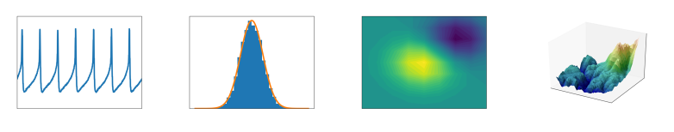
Matplotlib: introduction
Matplotlib is the most popular Python plotting library.
With it we can generate plots, histograms, power spectra, bar charts, errorcharts, scatterplots, etc., with just a few lines of code.
Here is an example of some different types of plots that can be created with Matplotlib
https://matplotlib.org/

Slide 7
Matplotlib APIs
Matplotlib has 3 different APIs to use for plotting:
The pyplot API
The object-oriented API
The pylab API
We will be mostly using the pyplot module of Matplotlib
Matplotlib works together with the NumPy package.
Plotting functions in Matplotlib expect as input either of:
numpy.array or numpy.ma.masked_array
If working with a Pandas DataFrame, Pandas offers a simple function .to_numpy() that converts the DataFrame to a numpy array
Notes:
The pyplot API: matplotlib.pyplot is a collection of command style functions that make Matplotlib work like MATLAB.
The object-oriented API: Matplotlib works with plotting objects like Figures and Axes, pyplot creates and changes these objects using functions but we can access the objects directly.
The pylab API: matplotlib.pylab is an older module that used to behave similarly to pyplot, but it has since been deprecated and its use is disapproved as some of its design decisions are discouraged.
https://pandas.pydata.org/pandas-docs/stable/reference/api/pandas.DataFrame.to_numpy.html#pandas.DataFrame.to_numpy

Slide 8
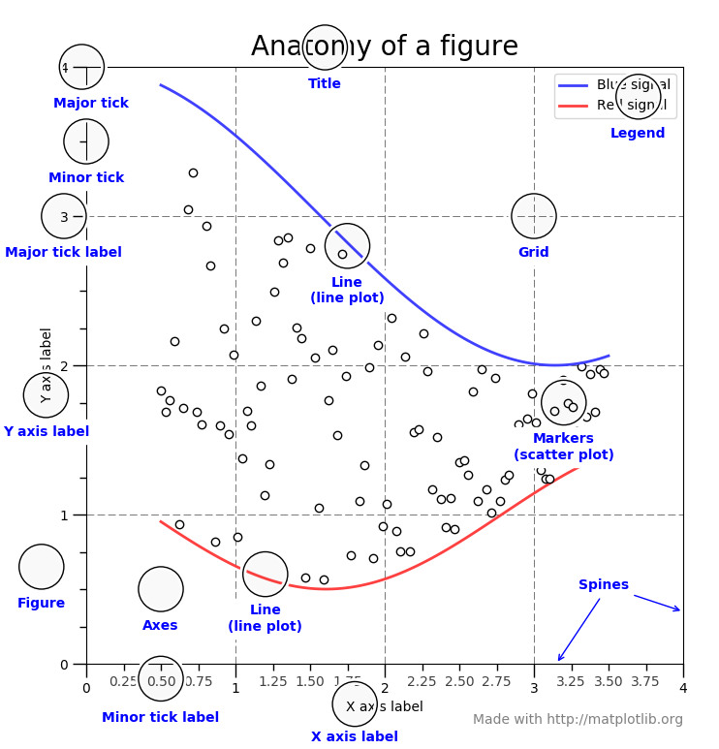
Data Visualisation with Matplotlib
In Matplotlib each graphical representation is called a Figure, the whole figure.
Figures have at least one Axes but can have multiple.
Axes are the data space, they contain Axis, x and y labels and limits, as well as titles, and is where the data is represented.
For the most part pyplot performs the creation and management of these objects for us.
Notes:
https://matplotlib.org/tutorials/introductory/usage.html#sphx-glr-tutorials-introductory-usage-py

Slide 9
Pyplot Functions
Pyplot has many different functions, here are some of them:
figure() | set_xlabel() | set_ylabel() | set_title() | legend()
show() | savefig() | bar() | subplot() | axis()
scatter() | plot() | suptitle() | grid() | set_xticks()
set_yticks() | set_xticklabel() | set_yticklabel() | hist() | hist2d()
arrow() | box() | draw() | errorbar() | get_figlabels()
polar() | stem() | specgram() | scatter() | subplots()
tight_layout() | xlim() | ylim() | xscale() | yscale()
triplot() | axes() | boxplot() | close() | figtext()
hexbin() | hlines() | vlines() | text() | table()
step() | spy() | loglog() | minorticks_on() | xkcd()
The complete pyplot documentation with description of all these and more can be found here: https://matplotlib.org/api/_as_gen/matplotlib.pyplot.html
Notes:
https://matplotlib.org/api/_as_gen/matplotlib.pyplot.html

Slide 10
Importing Matplotlib
To start, we need to import the pyplot module from matplotlib library
pyplot is mainly intended for interactive plots and simple cases of programmatic plot generation
It is common practice to use the alias ‘plt’ while importing the matplotlib library
>>> import matplotlib.pyplot as plt
>>> import numpy as np
Since matplotlib uses numpy arrays as input these are usually imported together
Notes:
Note: Matplotlib does not come with Python. You need to download and install it separately.

Slide 11
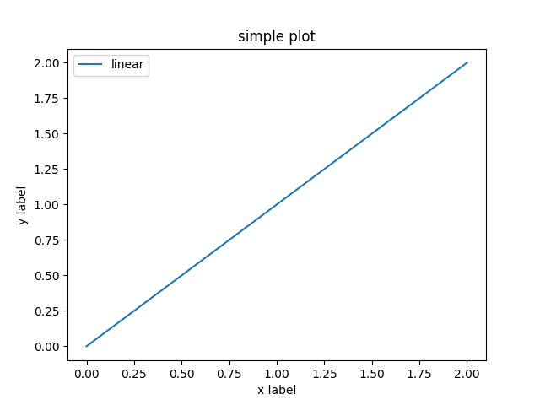
Matplotlib Example: Line Plot
Use the plot() function to draw line plots
import matplotlib.pyplot as plt
import numpy as np
x = np.linspace(0,2,100)
plt.plot(x, x, label='linear')
plt.xlabel('x label')
plt.ylabel('y label')
plt.title('simple plot')
plt.legend()
#plt.show()
plt.savefig('line_plot.png')
Notes:
Save this code in the python script named line_plot.py
In general, for this module save each python script using the same name as the plot it creates

Slide 12
Matplotlib Example: Line Plot
import matplotlib.pyplot as plt
import numpy as np
x = np.linspace(0,2,100)
plt.plot(x, x, label='linear')
plt.xlabel('x label')
plt.ylabel('y label')
plt.title('simple plot')
plt.legend()
#plt.show()
plt.savefig(‘line_plot.png')
Imports

Slide 13
Matplotlib Example: Line Plot
import matplotlib.pyplot as plt
import numpy as np
x = np.linspace(0,2,100)
plt.plot(x, x, label='linear')
plt.xlabel('x label')
plt.ylabel('y label')
plt.title('simple plot')
plt.legend()
#plt.show()
plt.savefig('line_plot.png')
The numpy linspace() function
returns an array of 100
evenly spaced elements
between 0 and 2

Slide 14
Matplotlib Example: Line Plot
Creating a plot with pyplot,
this plot() function takes in
an array for the horizontal
axis values (x), and the same
array for vertical axis values
(y = x in this example).
The keyword argument label
is used to set a label that will
be displayed in the legend
(linear in this example) .
import matplotlib.pyplot as plt
import numpy as np
x = np.linspace(0,2,100)
plt.plot(x, x, label='linear')
plt.xlabel('x label')
plt.ylabel('y label')
plt.title('simple plot')
plt.legend()
#plt.show()
plt.savefig('line_plot.png')
Notes:
Note: in general, the plot() function is used to draw points (markers) in a diagram.
By default, the plot() function draws a line from point to point.
The function takes parameters for specifying points in the diagram.
The first parameter is an array containing the points on the x-axis.
The second parameter is an array containing the points on the y-axis.
For example:
x_axis_points = np.arange(1, 11)
y_axis_points = np.arange(100, 1100, 100)
plt.plot(x_axis_points, y_axis_points)
plt.show()
Values don’t necessarily need to be numeric:
x_axis_points = np.array(['a', 'b', 'c', 'd', 'e', 'f'])
y_axis_points = np.array([34, 58, 72, 28, 84, 10])
plt.plot(x_axis_points, y_axis_points)
plt.show()

Slide 15
Matplotlib Example: Line Plot
import matplotlib.pyplot as plt
import numpy as np
x = np.linspace(0,2,100)
plt.plot(x, x, label='linear')
plt.xlabel('x label')
plt.ylabel('y label')
plt.title('simple plot')
plt.legend()
#plt.show()
plt.savefig(‘line_plot.png')
Setting the labels for our x and y axis,
then setting the title for our figure,
then adding a legend to our plot
Notes:
Note:
The position of the title can be regulated both horizontally and vertically.
Horizontally, through the kwarg loc: 'center', 'left', 'right’. The default is ‘center’ (aligned to the center of the plot),
Vertically, through the kwarg y. y=1 means at the highest y position in the plot. Anything below 1 would mean pushing title lower, while anything above 1 would mean pushing title further higher. The default is None, meaning that y is determined automatically to avoid decorators on the Axes.
Official documentation for plt.title():
https://matplotlib.org/stable/api/_as_gen/matplotlib.pyplot.title.html

Slide 16
Matplotlib Example: Line Plot
import matplotlib.pyplot as plt
import numpy as np
x = np.linspace(0,2,100)
plt.plot(x, x, label='linear')
plt.xlabel('x label')
plt.ylabel('y label')
plt.title('simple plot')
plt.legend()
#plt.show()
plt.savefig('line_plot.png')
Finally generating and
saving our figure to a
file ‘line_plot.png’.
The show() function opens
the figure in a window.
The savefig() function saves the figure to a file

Slide 17
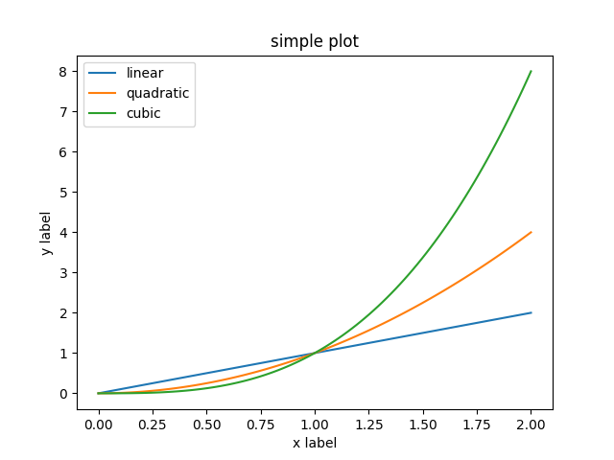
Matplotlib Example: Quadratic & Cubic Plots
import matplotlib.pyplot as plt
import numpy as np
x = np.linspace(0,2,100)
plt.plot(x, x, label='linear') plt.plot(x, x**2, label='quadratic') plt.plot(x, x**3, label='cubic')
plt.xlabel('x label')
plt.ylabel('y label')
plt.title('simple plot')
plt.legend()
#plt.show()
plt.savefig('multiple_line_plots.png')
Plots can be overlaid by using multiple plot() functions.
Here we added a quadratic and cubic plots to the existing linear plot
Notes:
In this example the values for the array x are created using the linspace() function as 100 evenly spaced numbers between 0 and 2.
The first plot uses the same x values for the variable y to produce the linear line plot.
The second plot squares the x values for the variable y to produce the quadratic line plot.
The second plot cubes the x values for the variable y to produce the cubic line plot.
The label keyword argument is used to set a label that will be displayed in the legend (in this example linear, quadratic and cubic).
Save this code in the python script named multiple_line_plots.py

Slide 18
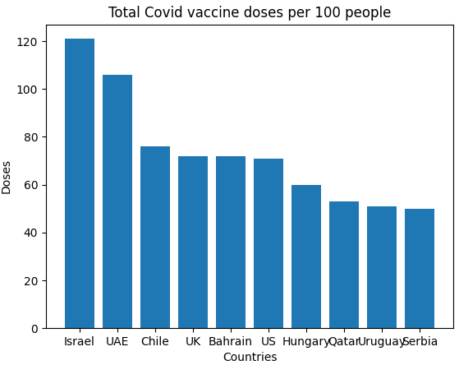
Matplotlib Example: Column Plot
import matplotlib.pyplot as plt
import numpy as np
# total covid vaccine doses per 100 people
x = np.array(['Israel', 'UAE', 'Chile', 'UK', \
'Bahrain', 'US', 'Hungary', \
'Qatar', 'Uruguay', 'Serbia'])
y = np.array([121, 106, 76, 72, 72, 71, \
60, 53, 51, 50])
plt.xlabel('Countries')
plt.ylabel('Doses')
plt.title('Total Covid vaccine doses per 100 people')
plt.bar(x,y)
plt.savefig('column_plot.png')
Use the bar() function to draw column plots
Notes:
Note 1: when values for x and y coordinates are provided, their number must be equal
Note 2: The default bar’s width (if not assigned a different value) is 0.8 units. We may assign a new value in the range [0.0, 1.0]. Note that a bar with width 0.0 will be inexistent.
Notice also the point where the first tick appears on the x-axis: at half of the first bar’s width. The remaining ticks appear at half width of the each of the remaining bar.
This ensures a space between the y-axis and the left edge of the first bar.
The distance between the bars is calculated as 1 - n_bars * bar_width. In this case, this space will be 1 – 1 * 0.8 = 0.2 units.
https://www.tutorialkart.com/matplotlib-tutorial/matplotlib-pyplot-bar-plot-width
https://github.com/matplotlib/matplotlib/issues/13236
Save this code in the python script named column_plot.py

Slide 19
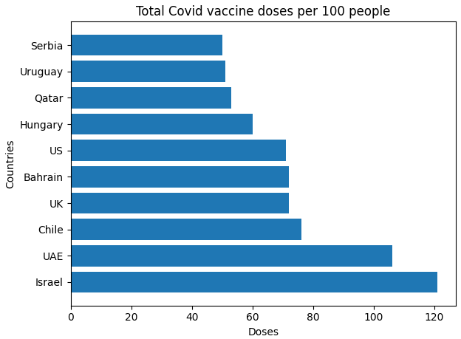
Matplotlib Example: Bar Plot
import matplotlib.pyplot as plt
import numpy as np
# total covid vaccine doses per 100 people
x = np.array(['Israel', 'UAE', 'Chile', 'UK', \
'Bahrain', 'US', 'Hungary', \
'Qatar', 'Uruguay', 'Serbia'])
y = np.array([121, 106, 76, 72, 72, 71, \
60, 53, 51, 50])
plt.xlabel('Doses')
plt.ylabel('Countries')
plt.title('Total Covid vaccine doses per 100 people')
plt.barh(x,y)
plt.tight_layout()
plt.savefig('bar_plot.png')
Use the barh() function to draw bar plots
Notes:
Note 1:
plt.barh(x, y) is used to specify that the bar chart is to be plotted by using the countries array (x) as values on the y-axis, and the doses array (y) as values on the x-axis. In order to match on the plot, the labels must be swapped around.
Note 2:
Because some of the values on the y-axis are relatively long, the y-axis label ‘Countries’ is truncated to the left. To adjust the plot use matplotlib function tight_layout() which automatically adjusts the figure area.
Note 3: To set the width of horizontal bars, use height instead of width. The default height value is 0.8. To see the effect of changing the width of horizontal bars, replace the statement plt.barh(x, y) with plt.barh(x, y, height = 0.1).
Save this code in the python script named bar_plot.py

Slide 20
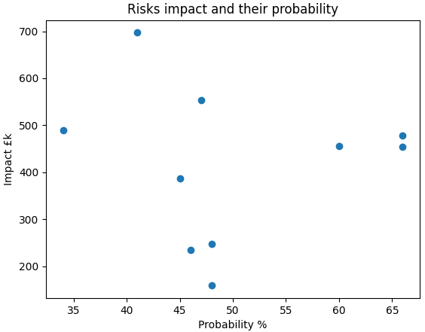
Matplotlib Example: Scatterplot
The scatter() function plots one dot for each (x, y) pair.
import matplotlib.pyplot as plt
import numpy as np # impact (in £k) of potential risks by % of their probability x = np.array([60, 46, 66, 48, 48, \
34, 41, 47, 45, 66])
y = np.array([456, 235, 478, 159, 248, \
490, 697, 554, 387, 454])
plt.xlabel('Probability %')
plt.ylabel('Impact £k')
plt.title('Risks impact and their probability')
plt.scatter(x,y)
plt.savefig('scatter_plot.png')
Use the scatter() function to draw scatter plots
Notes:
Save this code in the python script named scatter_plot.py

Slide 21
Matplotlib Example: Grouped Bar Plot
Use the subplots() function to draw a grouped bar chart
import matplotlib.pyplot as plt
import numpy as np
no_age_groups = 6
male = np.array([235, 621, 823, 421, 120, 13])
female = np.array([435, 924, 532, 264, 125, 3])
fig, ax = plt.subplots()
index = np.arange(no_age_groups)
bar_width = 0.35
male_bars = ax.bar(index, male, bar_width, color='k', label='male') female_bars = ax.bar(index + bar_width, female, bar_width, color='0.5', label='female')
Notes:
Example explained
fig, ax = plt.subplots(): subplots() function returns both the figure object (fig), and axes (ax) which is a nrows x ncols array of axes objects, allowing you to easily access each subplot. If not specified, nrows and ncols of the subplot grid is 1 by default. Here subplots() returns a figure fig and a 1x1 (single) axes object (ax).
index = np.arange(no_age_groups): For integer arguments the function arrange is equivalent to the Python built-in range function, but returns an NumPy array rather than a list. Here index = array([0, 1, 2, 3, 4, 5])
bar_width = 0.35 sets the width of the bar (in units): value in the interval (0, 1]
ax.bar(index, male, bar_width, color='k', label = 'male’) creates bars at each index with male values and black colour. Bars are placed so that each index: 0, 1, 2, 3, 4, 5 is at the centre (half way) of the bar’s width.
Position 0 is not where the intersection between x and y axis is. The default position 0 is at half of the width of the first bar. This is to leave some space between the y-axis and the left edge of the first bar.
There are many different formats to specify a value for color in matplotlib. In the above example the following two formats are used:
one of the characters {'b', 'g', 'r', 'c', 'm', 'y', 'k', 'w'}, which are short-hand notations for shades of blue, green, red, cyan, magenta, yellow, black, and white
a string representation of a float value within the interval [0, 1] inclusive, for grey level (e.g., ’0.8’); 0=black, 1=white
More info on colors in matplotlib: https://matplotlib.org/stable/api/colors_api.html?highlight=color#module-matplotlib.colors
female_bars = ax.bar(index + bar_width, female, bar_width, color='0.5', label = 'female’) creates bars at each index with female values in 0.5 shade of grey (0 is black, 1 is white). The half point of the female bars will be placed 0.35 units away from the half point of the related male bar’s width. This will make female bars sit right after the related male bar: The middle of male bars at position 0, 1, 2, 3, 4, 5 and the middle of female bars at position 0.35, 1.35, 2.35, 3.35, 4.35, 5.35. Female bars will be shifted bar_width (0.35) units from the corresponding male bars.
https://www.tutorialspoint.com/matplotlib/matplotlib_subplots_function.htm
Official documentation:
https://matplotlib.org/stable/api/_as_gen/matplotlib.pyplot.subplots.html
https://matplotlib.org/stable/api/_as_gen/matplotlib.pyplot.bar.html

Slide 22
Matplotlib Example: Grouped Bar Plot
ax.set_facecolor('orange') # sets the background colour of the plot
ax.set_xlabel('Age group') # sets the x-axis label
ax.set_ylabel('Number of employees’) # sets the y-axis label
ax.set_title('Number of employees by gender and age group’) # sets the plot title
ax.set_xticks(index + bar_width/2) # places the ticks right between the male and female bars
ax.set_xticklabels(('18-25', '26-34', '35-44', '45-54', '55-64', '65+'))
ax.bar_label(male_bars, padding=3) # add values as labels to male bars
ax.bar_label(female_bars, padding=3) # add values as labels to female bars
ax.legend()
fig.tight_layout()
plt.savefig('grouped_bar_plot.png')
Notes:
Example explained (continued)
ax.set_xticks(index + bar_width/2): By default (without calling the set_xticks() function, or if the argument index is passed to the set_xticks() function), the first tick will be positioned at half of the width of the first (male) bar - here 0.175 because the bar width is set to 0.35. The distance between ticks from that point on is the same as they are positioned at half of each (male) bar’s width. To move the ticks right between the male and female bars, the argument passed to set_xticks() function is: index + bar_width/2, which will move the tick from the default position (at half male bar’s width) to the new position (precisely between the male and female bars).
Remember that position 0 is at half of the width of the first bar.
ax.set_xticklabels(('18-25', '26-34', '35-44', '45-54', '55-64', '65+’)): sets the labels below each tick of the x-axis
Warning:
ax.set_xticklabels method should only be used after fixing the tick positions using ax.set_xticks. Otherwise, the labels may end up in unexpected positions.
ax.bar_label(male_bars, padding=3): adds values held in the container (here male_bars) to bars, by default at the top of bars, with padding (in points) to provide some distance between the top of the bars and the values.
To display values in the centre, set the kwarg label_type to center: label_type=‘center’
Official documentation:
https://matplotlib.org/stable/api/_as_gen/matplotlib.axes.Axes.set_xticks.html
https://matplotlib.org/stable/api/_as_gen/matplotlib.axes.Axes.set_xticklabels.html
https://matplotlib.org/stable/api/_as_gen/matplotlib.pyplot.bar_label.html

Slide 23
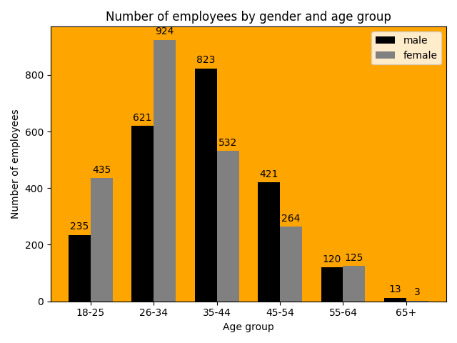
Matplotlib Example: Grouped Bar Plot
Grouped bar chart with bar labels
The default point 0 is in the middle of the first male bar
This is where the default first tick would be – to see it, comment out the line of code: ax.set_xticks(index + bar_width/2)
In order to shift the ticks between the male and female bars (as in the plot on the left), the index values: 0, 1, 2, 3, 4, 5 are increased by half of bar’s width to values 0.175, 1.175, 2.175, 3.175, 4.175, 5.175

Slide 24
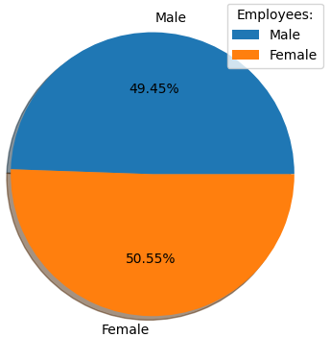
Matplotlib Example: Pie Plot
Let’s create a pie plot to show the proportion of men and women: using pie() function
import matplotlib.pyplot as plt
import numpy as np
male = np.array([235, 621, 823, 421, 120, 13])
female = np.array([435, 924, 532, 264, 125, 3])
tot_male = np.sum(male)
tot_female = np.sum(female)
tot_employees = np.array([tot_male, tot_female])
pie_labels = ["Male", "Female"]
plt.pie(tot_employees, labels=pie_labels, autopct='%.2f%%', shadow=True)
plt.legend(title="Employees:")
plt.savefig('pie_plot.png')
Notes:
A pie chart is a type of graph in which a circle is partitioned into sectors (also called wedges or slices) occupying relative area of data.
By default the plotting of the first wedge starts from the x-axis and move counterclockwise.
The size of each wedge is determined by comparing the value with all the other values, by using this formula:
the value divided by the sum of all values: x/sum(x).
Here, the size of the first wedge is male employees/total employees: 235+621+823+421+120+13 = 2233; the total number of employees is 4516, the size of the first wedge (couterclockwise) is: 2233/4516 = 0.4944 (49.44%)
The size of the second wedge is female employees/total employees: 435+924+532+264+125+3 = 2283; 2283/4516=0.5055 (50.55%)
The parameter autopct is used to label the wedges with their numeric value. The label will be placed inside the wedge. Using Python string formatting, autopct enables displaying the percentage value of each slice.
To display each slice as percentage value
to 1 decimal place, write autopct = '%.1f’
to 2 decimal places, write autopct = ‘%.2f’
To show the % symbol on the pie chart, write/add autopct = ‘%.2f%%’
The shadow parameter draws a shadow beneath the pie slices

Slide 25
Matplotlib Example: Subplots – method 1
Use the subplots() function to draw multiple plots in one figure, for example the bar and pie plot we’ve just created
import matplotlib.pyplot as plt
import numpy as np
# plot 1: number of male and female employees in a company, broken down by their age
no_age_groups = 6
male = np.array([235, 621, 823, 421, 120, 13])
female = np.array([435, 924, 532, 264, 125, 3])
fig, ax = plt.subplots(1, 2, figsize=(12, 6))
Notes:
We’ve seen how without arguments passed to it, subplots() can be used to group together bar charts in one plot.
With arguments passed to it, subplots() function creates multiple plots in one figure.
Syntax:
subplots(numrows, numcols)
numrows – number of rows in the figure
numcols – number of columns in the figure
subplots() function allows creating a figure with several subplots, with only one line of code.
The method figsize(width, height) allows changing the size of the figure. The default size (in inches) is (6.4, 4.8).
Alternative way of changing the size of the figure to 12x6 is:
fig.set_figwidth(12)
fig.set_figheight(6)

Slide 26
Matplotlib Example: Subplots – method 1
index = np.arange(no_age_groups)
bar_width = 0.35 # bar width (0.35 units)
male_bars = ax[0].bar(index, male, bar_width, color='k', label='male')
female_bars = ax[0].bar(index + bar_width, female, bar_width, color='0.5', label='female’)
ax[0].set_facecolor('orange’) # sets the background colour of the plot
ax[0].set_xlabel('Age group')
ax[0].set_ylabel('Number of employees')
ax[0].set_title('Number of employees by gender and age group')
ax[0].set_xticks(index + bar_width/2)
ax[0].set_xticklabels(('18-25', '26-34', '35-44', '45-54', '55-64', '65+'))
ax[0].bar_label(male_bars, padding=3) # add values as labels to male bars
ax[0].bar_label(female_bars, padding=3) # add values as labels to female bars
ax[0].legend()
Notes:
Once created access each subplot through the subscript operator:
ax[0] refers to the first plot

Slide 27
Matplotlib Example: Subplots – method 1
# plot 2: proportion of male and female employees
tot_male = np.sum(male)
tot_female = np.sum(female)
tot_employees = np.array([tot_male, tot_female])
pie_labels = "Male", "Female"
ax[1].set_title("Proportion of employees by gender")
ax[1].pie(tot_employees, explode=None, labels=None, autopct='%0.2f%%', shadow=True)
ax[1].axis('equal') # equal aspect ratio ensures that pie is drawn as a circle.
ax[1].legend(pie_labels)
fig.tight_layout()
plt.savefig('subplots_v1.png')
Notes:
ax[1] refers to the second plot
By setting the labels parameter in pie() function to None, the labels are not added to the pie chart. The labels are kept in the legend though, with the command ax[1].legend(pie_labels)
The explode feature allows separating the slices of the pie chart. Set the parameter explode to a variable that identifies the tuple, containing a positive value for each slice you wish to explode, where the numbers indicates the fractions of the radius of the pie. For example set the tuple explode_female = (0, 0.1), and then set the parameter explode to explode_female in the pie() function, to see how it works:
ax[1].pie(tot_employees, explode=explode_female, labels=None, autopct='%0.2f%%', shadow=True)
The above command expands the female slice by 0.1 fraction of the radius of the pie.

Slide 28
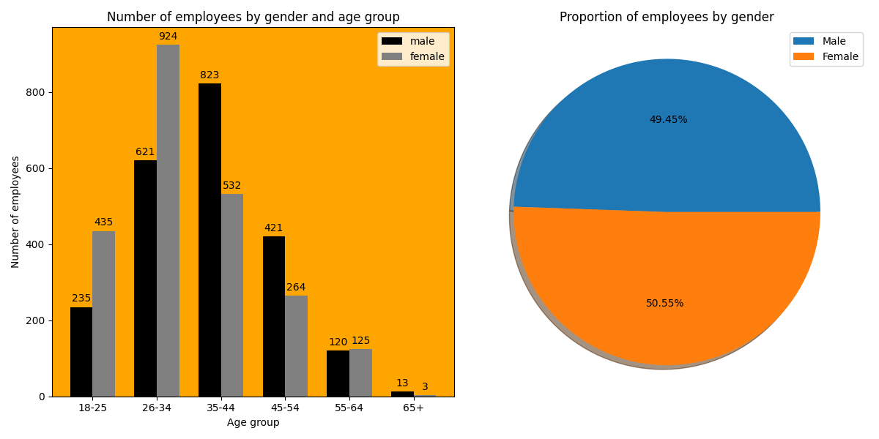
Matplotlib Example: Subplots – method 1
Notes:
Note: the location of the legend can be changed using the loc keyword argument.
By default loc='upper right’
Other values for loc are: 'upper left', 'lower left', 'lower right', 'upper center', 'lower center', 'center left', 'center right', 'center' and 'best’.
https://matplotlib.org/stable/api/_as_gen/matplotlib.pyplot.legend.html

Slide 29
Matplotlib Example: Subplot – method 2
Use the subplot() function to draw multiple plots in one figure
import matplotlib.pyplot as plt import numpy as np # first make the figure fig = plt.figure(figsize=(12,6)) # now create each subplot individually # plot 1: no_age_groups = 6 male = np.array([235, 621, 823, 421, 120, 13]) female = np.array([435, 924, 532, 264, 125, 3]) index = np.arange(no_age_groups) bar_width = 0.35 ax1 = plt.subplot(1, 2, 1) male_bars = ax1.bar(index, male, bar_width, color='k', label='male') female_bars = ax1.bar(index + bar_width, female, bar_width, color='0.5', label='female')
Notes:
Multiple plots in one figure can also be created with the subplot() function, called once for each subplot. However, subplot() does not create a figure; this needs to be done separately, by calling the figure() function.
https://matplotlib.org/stable/api/_as_gen/matplotlib.pyplot.figure.html
Syntax:
subplot(numrows, numcols, plot_number)
numrows – number of rows in the figure
numcols – number of columns in the figure
plot_number – index of the current plot, where plot_number ranges from 1 to numrows*numcols.
The commas in the subplot() function are optional if numrows*numcols<10. So subplot(121) is identical to subplot(1, 2, 1) – meaning the figure consists of 2 plots: placed in two columns over 1 row and the current plot is the left one.
subplot() creates only a single subplot axes at a specified grid position. This means that every plot is created through a separate subplot() function call, such as (here):
ax1 = plt.subplot(1, 2, 1)
ax2 = plt.subplot(1, 2, 2)
Since these are different plots, they are accessible through their own names (here ax1 and ax2), instead of ax[0] and ax[1] in case of subplots().

Slide 30
Matplotlib Example: Subplot – method 2
ax1.set_facecolor('orange') # sets the background colour of the plot
ax1.set_xlabel('Age group')
ax1.set_ylabel('Number of employees')
ax1.set_title('Number of employees by gender and age group')
ax1.set_xticks(index + bar_width/2)
ax1.set_xticklabels(('18-25', '26-34', '35-44', '45-54', '55-64', '65+'))
ax1.bar_label(male_bars, padding=3) # add values as labels to male bars
ax1.bar_label(female_bars, padding=3) # add values as labels to female bars
ax1.legend() # plot 2: tot_male = np.sum(male) tot_female = np.sum(female) tot_employees = np.array([tot_male, tot_female]) pie_labels = "Male", "Female" ax2 = plt.subplot(1, 2, 2) ax2.pie(tot_employees, explode=None, labels=None, autopct='%.2f%%', shadow=True)

Slide 31
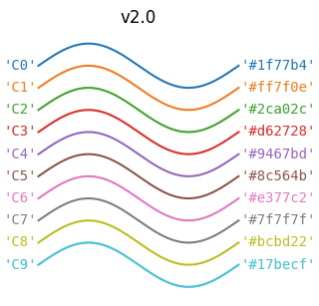
Matplotlib Example: Subplot – method 2
ax2.axis('equal') # equal aspect ratio (scaling) ensures that pie is drawn as a circle
ax2.set_title("Proportion of employees by gender")
ax2.legend(pie_labels)
fig.tight_layout()
#plt.show()
plt.savefig('subplot_v2.png')
The outcome of the above script is the same plot with two subplots as shown in slide 28
Change the colour of the male bars to the same shade of blue in the pie chart: #1f77b4
Change the colour of the female bars to the same shade of orange in the pie chart: #ff7f0e
Change the background colour of the bar chart from ‘orange’ to ‘white’
The resulting plot with two subplots is shown in the next slide
The image on the right shows the 10 default colours used for plots with their hex code
Notes:
Source: https://scriptverse.academy/tutorials/python-matplotlib-pie-chart.html
If we use "equal" as an aspect ratio in the axis() function, we get a plot with the same scaling from data points to plot units for x-axis and y-axis.

Slide 32
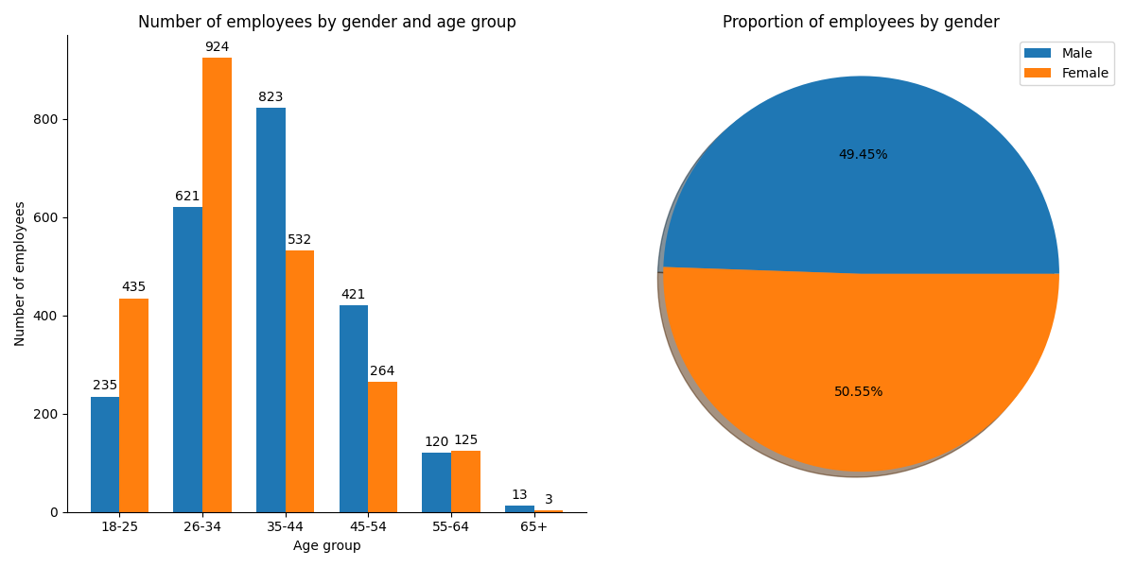
Matplotlib Example: Subplot – method 2
Notes:
The above plot features the default blue colour for male data: ='#1f77b4’ (‘C0’) and the default orange colour for female data: ='#ff7f0e’ (‘C1’). The background of the first plot is set to ‘white’
male_bars = ax[0].bar(index, male, bar_width, color='#1f77b4', label = 'male’) # sets the ‘male’ bars to default blue colour
female_bars = ax[0].bar(index + bar_width, female, bar_width, color='#ff7f0e', label = 'female’) # sets the ‘female’ bars to default orange colour
ax[0].set_facecolor('white’) # sets the background of the first plot to white colour
The top and right edges of the first plot can be removed (hidden):
ax[0].spines['right'].set_visible(False)
ax[0].spines['top'].set_visible(False)
Since the legend of both plots is the same, one of them can be removed, for example to remove the first one (leaving only the legend on the top right corner), remove the line of code:
ax[0].legend()

Slide 33
Matplotlib from Pandas DataFrame (1)
Matplotlib is designed to work with NumPy arrays, but Pandas includes to_numpy() function that converts a DataFrame to NumPy array
This is useful if you already have created the DataFrame, but want to draw a related plot using Matplotlib
# import necessary libraries
import matplotlib.pyplot as plt
import numpy as np
import pandas as pd
# read all data stored as a csv file into a pandas DataFrame
df_sales = pd.read_csv('sales_by_customer_and_payment.csv')
# calculate total sales grouped by Customer Type & Payment Type
df_groupby = df_sales.groupby(['Customer Type', 'Payment Type']).sum()
# split existing index into columns (Customer Type & Payment Type) and add default index
df_groupby_ind = df_groupby.reset_index()
Notes:
The code on this slide produces the following DataFrame:
Customer Type Payment Type Sale
0 Business Online 1030
1 Business Telephone 879
2 Individual Online 564
3 Individual Telephone 1106

Slide 34
Matplotlib from Pandas DataFrame (2)
# extract the necessary data for the plot
customer_types = df_groupby_ind['Customer Type'].unique()
telephone_data = df_groupby_ind.query("`Payment Type`=='Telephone'").iloc[:,2].to_numpy()
online_data = df_groupby_ind.query("`Payment Type`=='Online'").iloc[:,2].to_numpy()
# draw the plot
no_customer_types = len(customer_types)
bar_width = 0.45
fig, ax = plt.subplots()
index = np.arange(no_customer_types)
telephone_bars = ax.bar(index, telephone_data, bar_width, label='telephone')
online_bars = ax.bar(index + bar_width, online_data, bar_width, label='online')
Notes:
The first three lines of code on this slide produce the following NumPy arrays:
customer_types = ['Business' 'Individual']
telephone_data = [ 879 1106]
online_data = [1030 564]
At this point we are ready to draw and customise the plot using Matplotlib functionalities.

Slide 35
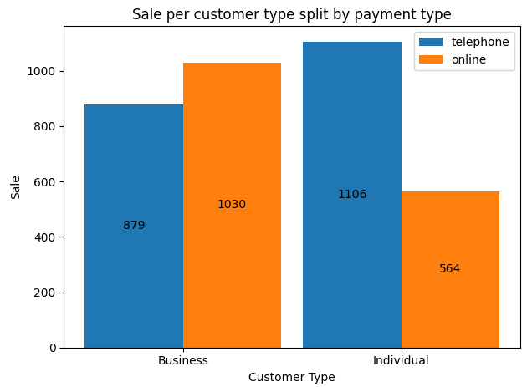
Matplotlib from Pandas DataFrame (3)
# place the ticks between drink and food bars
ax.set_xticks(index + bar_width/2)
# set the x tick labels (x-axis labels)
ax.set_xticklabels(customer_types)
# add values to telephone and online bars
ax.bar_label(telephone_bars, label_type='center')
ax.bar_label(online_bars, label_type='center’)
# add the legend
ax.legend()
# display the plot
fig.tight_layout()
plt.show()

Slide 36
Questions

Slide 37
Module Summary
Matplotlib is the most popular Python plotting library, used for making 2D plots from data in arrays
Since matplotlib uses NumPy arrays as input these libraries are usually imported together
pyplot is one of the 3 Matplotlib modules used for plotting, mainly intended for interactive plots and simple cases of programmatic plot generation
show() function displays the plot in a window
savefig() function saves the plot to a file
plot() function draws line plots
bar() function draws column plots

Slide 38
Module Summary
barh() function draws bar plots
scatter() function draws scatter plots
pie() function draws pie plots
subplots() function can be used to draw grouped bar plots
There are two ways of drawing multiple plots in one figure:
subplots() function - called once only (for all subplots), assigning all subplots to a variable; once created access each subplot through the subscript operator
subplot() function - called once for each subplot, assigning each subplot to a variable; subplot() does not create a figure; this needs to be done separately, by calling the figure() function.

